Slide 1
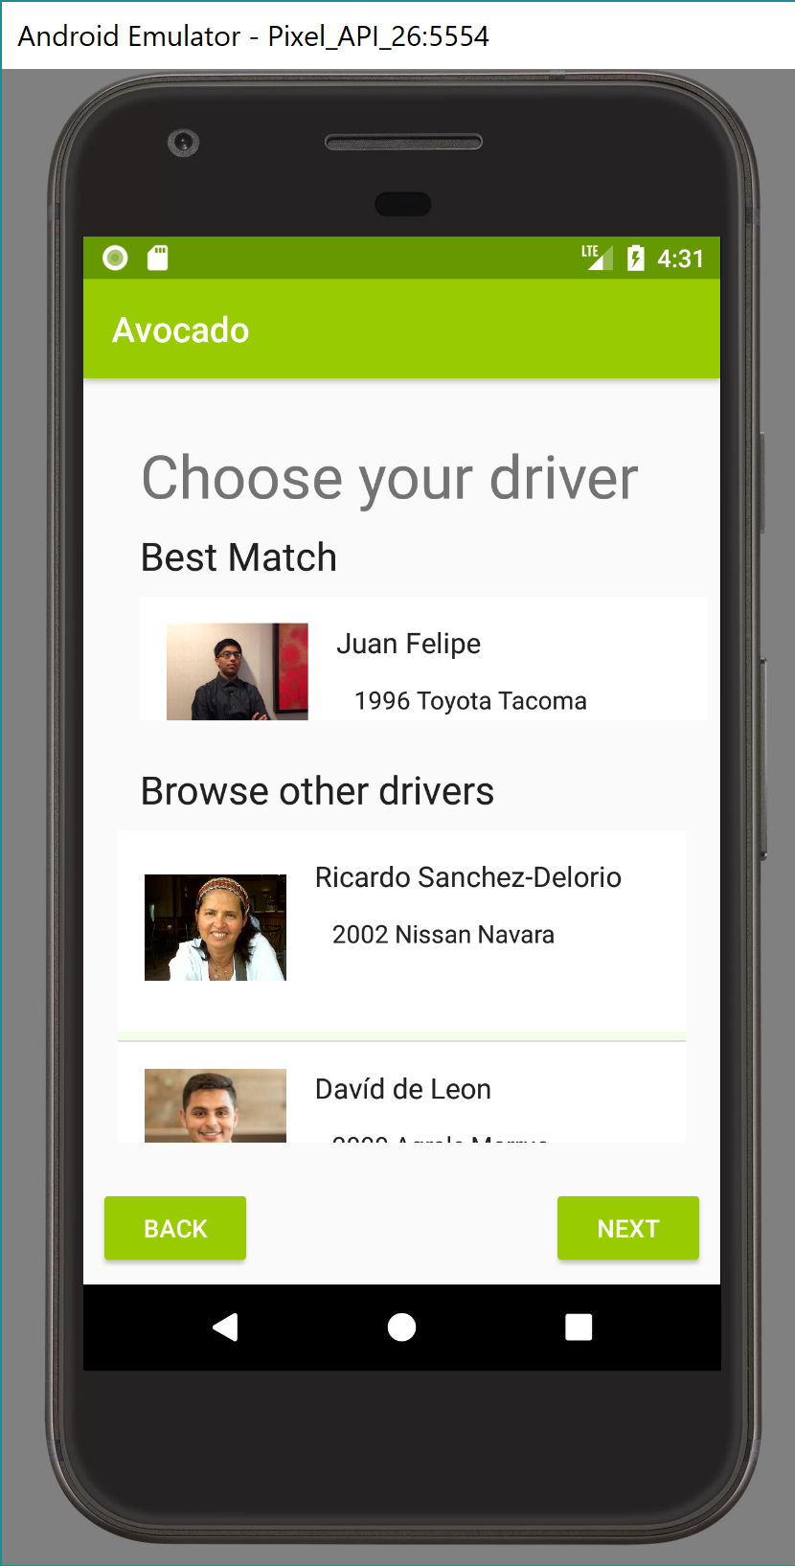
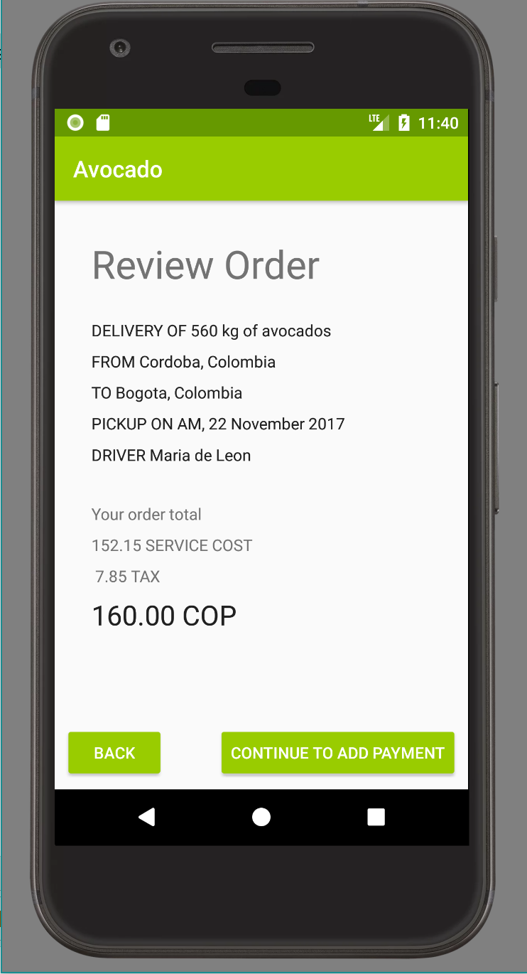
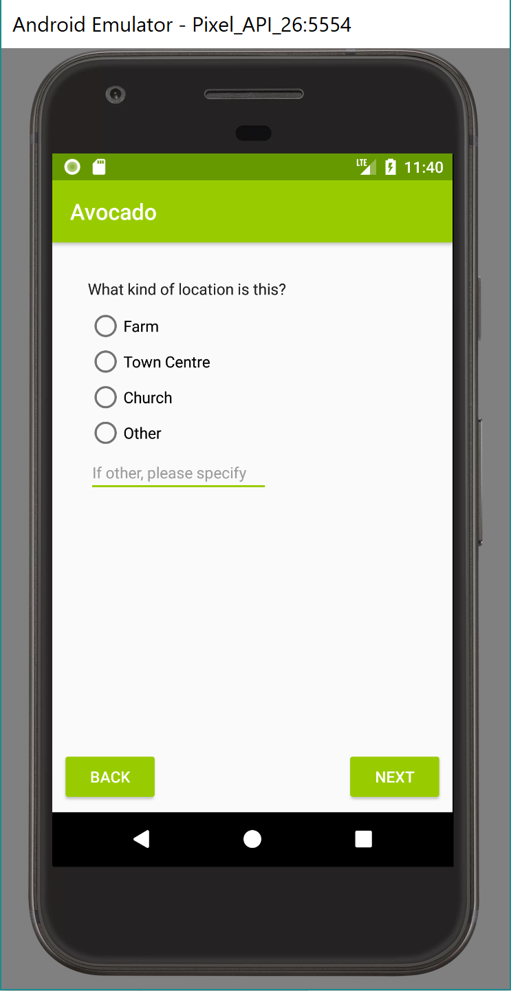
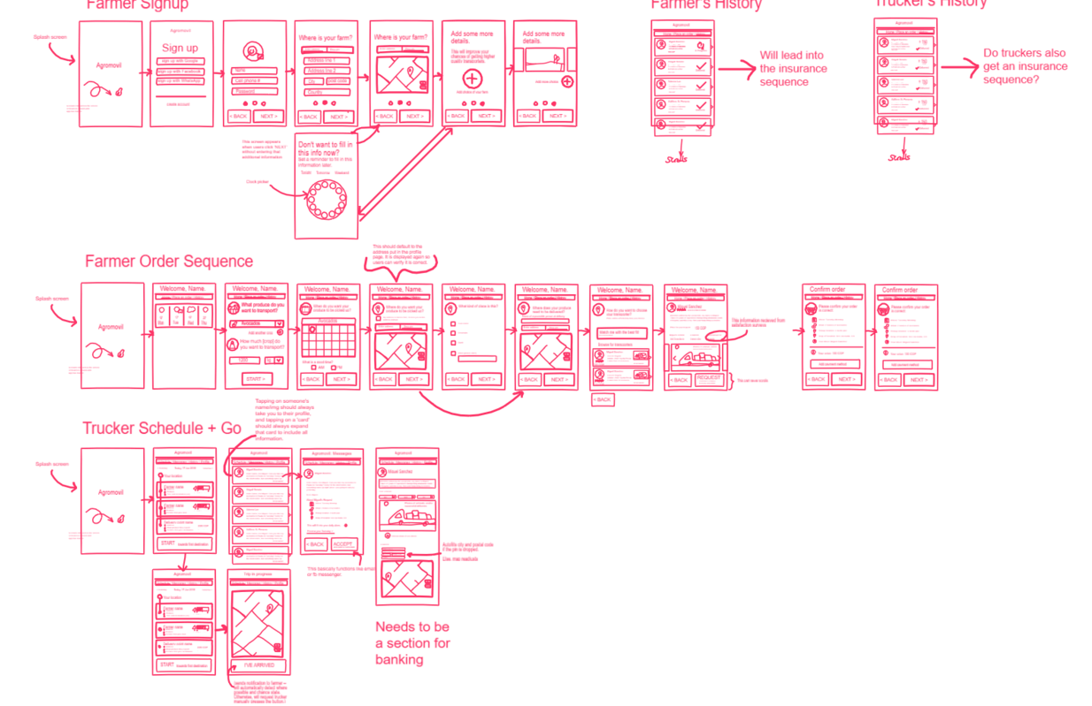
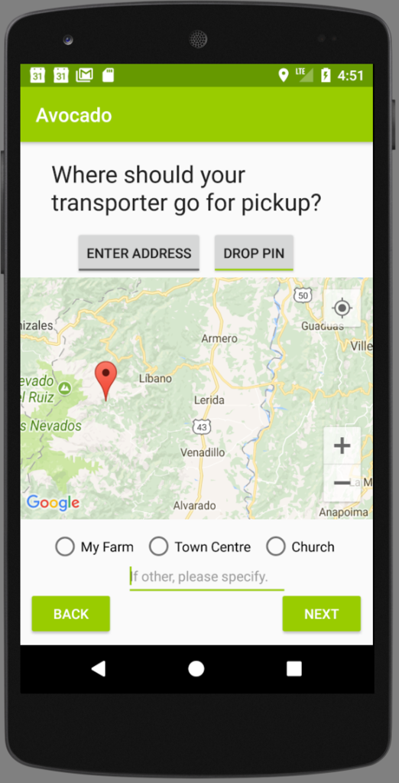
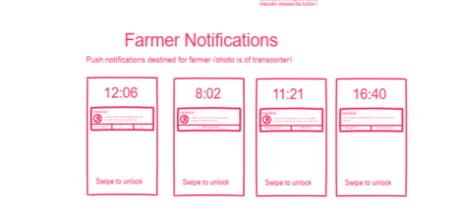
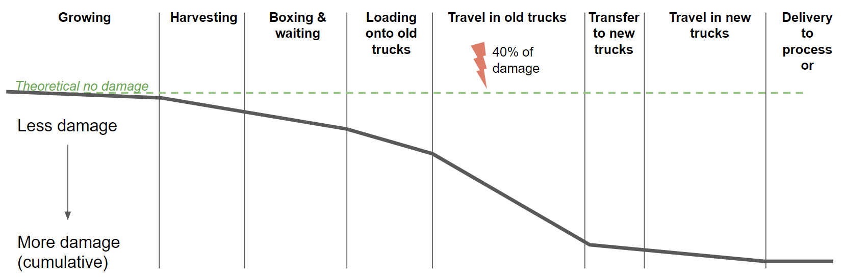
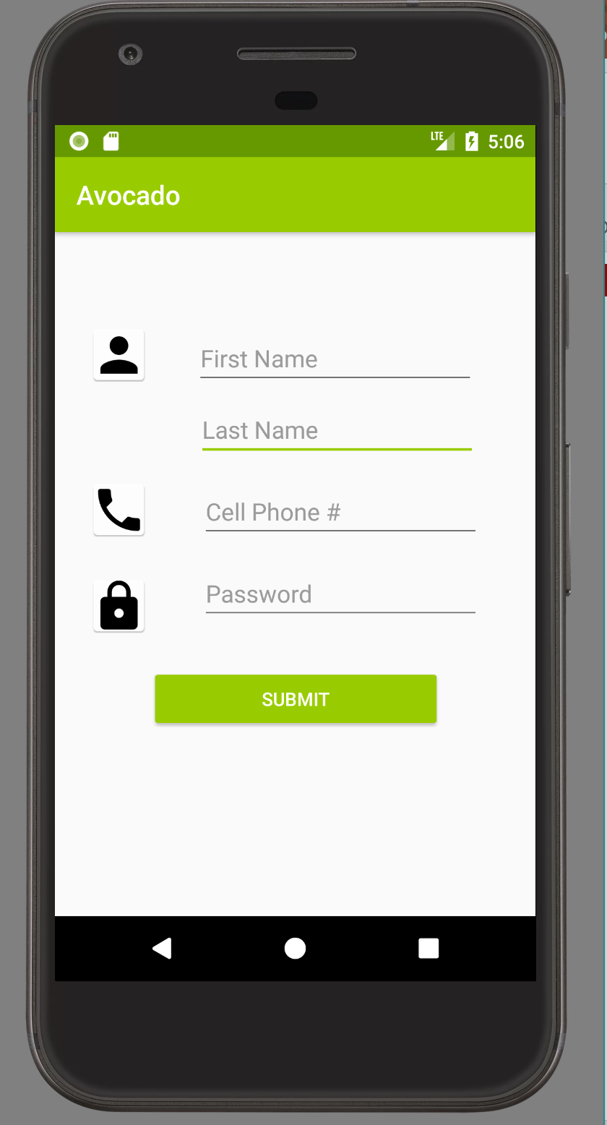
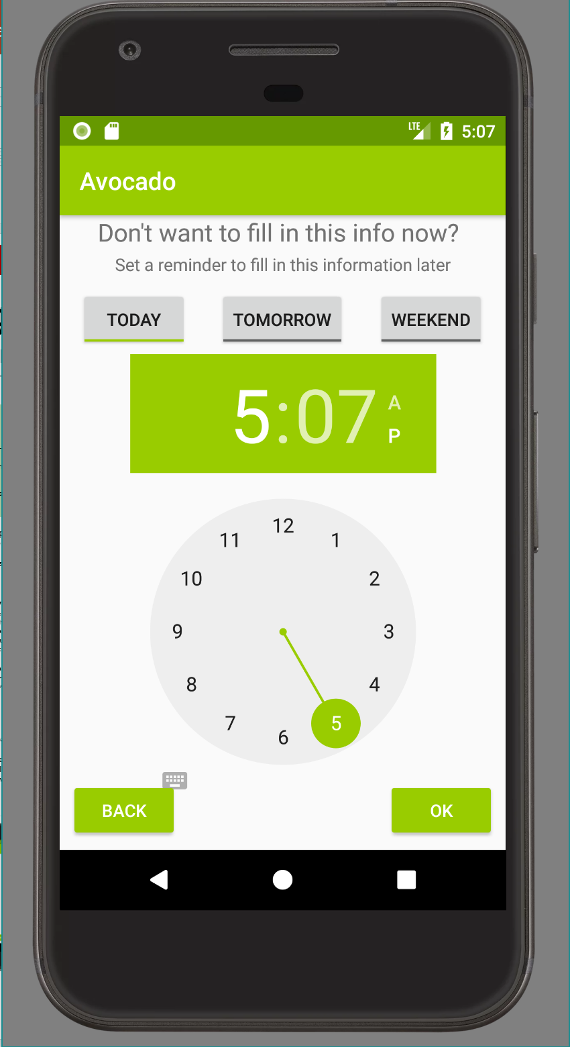
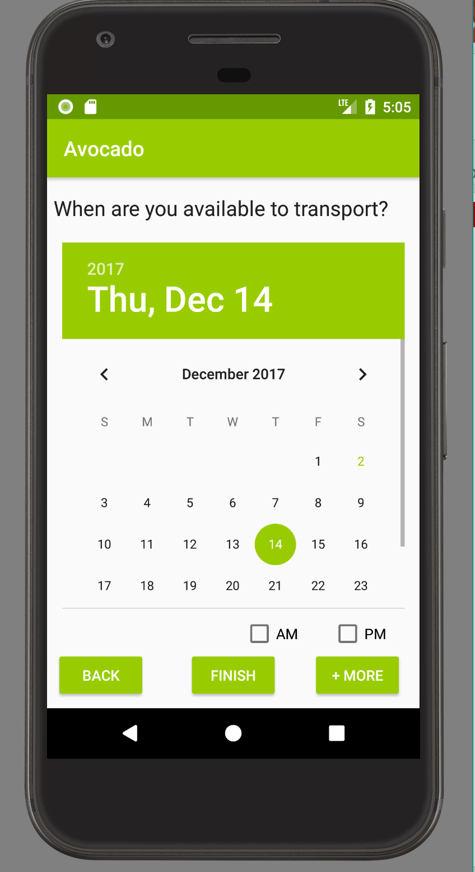
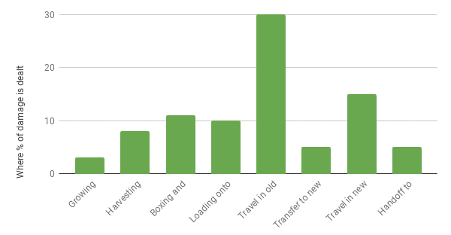
Computing for Good @ Carnegie Mellon University
Agromovil: an app platform to sustainably reduce post-harvest loss in the developing world
Kristina Wagner, Kylee Santos, Arka Roy, Jeremy Xue and Joyce Moon Instructors: Anind Dey and Afsaneh Doryab, Mentors: John Peha, Andrew Mack and Raza Khan
Problem: 30-50% of harvested crops in the developing world never make it to consumers.
The world’s 500 million small farmers produce about $500 billion in crops every year, but more than a third – an estimated $150 Billion – is wasted.
Food is lost, it rots, is eaten by pests, or never picked up, but the hard work of agriculture has been done. The weak link is logistics: getting goods from small rural farmers to urban markets.
Here’s what we’re doing differently
The world’s population continues to grow exponentially. We need more food to feed our burgeoning population. Experts are already working to:
Increase harvest yield, especially through chemical treatment of crops
Encouraging local produce consumption
Increasing food security through improved storage
The “Ugly Food” movement, which encourages consumers to accept imperfect crops
Avocado Journey Map showing where damage to avocados occurs
While many avocados are not damaged per se while they are waiting to be picked up, their value decreases as they have a short shelf lives.
Chart showing damage to avocados at different stages of the customer journey map, as a percentage of overall damage to avocados
Key Research Insights
Old trucks are not permitted within city limits due to emissions regulations. Produce destined for cities must be transferred between vehicles, which causes more damage.
These old trucks have more suspension, which damages produce more than a new truck would. However, the bad roads wear down new trucks.
Farmers in coops have much better access to transporters than independent farmers.
Solution: We help match farmers with transporters to get produce to market in a short amount of time, with minimal damage through a mobile app
We opted to focus on the 3rd point first, since it seems the least reliant on 3rd parties or the intervention of a government. Agromovil is an app platform to sustainably reduce post-harvest loss in the developing world.
Our app functionality
Schedule planning for drivers, so they can optimize their trips
Alert local farmers when a trucker is coming already scheduled to come through, to improve bundling of crops. This, in turn, reduces price of transit overall.
Ability for transporters can track their income through the history feature
Browsable list of nearby farmers/transporters to schedule crop pickups with.
Next Steps: Our research identified more possible solutions and improvements.
Road quality data and the quality of a truck and driver. This data would be collected from the phone’s sensors, including the accelerometer, gyroscope and GPS.
Unmapped Colombian roads could be added to Google Maps, thanks to the same smartphone data.
Bumpy roads be identified and presented to the Colombian government as candidates for repair work and other infrastructure improvement programs
Currently, farmers have no way of knowing how a transporter affects the quality of their produce. In the future, it would be ideal to have a means of evaluating the quality of the avocados at delivery to the processor, which could be used in turn as a measure of quality of the transporter.
Attaching slightly higher price tags to transporters who deliver higher quality produce would incentivize drivers to invest in higher quality trucks wherever possible, or to start building up some extra capital.
Challenges
The roads in rural Colombia are not mapped, making farms and routes challenging for transporters to find
The roads in Colombia are so bad they damage produce on their way to market
Phone networks are bad / low-bandwidth / unreliable
Farmers are most comfortable with transporters they know personally
Farmers who aren’t in a coop have greatly reduced access to transporters
How we’ve addressed some challenges:
Farms are often difficult to find. In response, we have
Made it possible to drop a pin anywhere on a map, even if there is no road nearby.
Allowed farmers to schedule meeting points at a crossroad, town center, intersection or other noticeable landmark that might be more recognizable than their farm
Allowed farmers to enter an address, and then immediately update the map so that farmers can correct for errors
We requires a lot of information upon signup, especially from transporters.
We allow transporters to skip some of the information screens, but ask them to set a reminder to upload (for example) images to their truck at a later time, specified by them.
Users don’t like remembering information like usernames.
Their ‘username’ or unique identifying string is their phone number.
Screens corresponding to Challenge solutions

Slide 2
